Slide 1
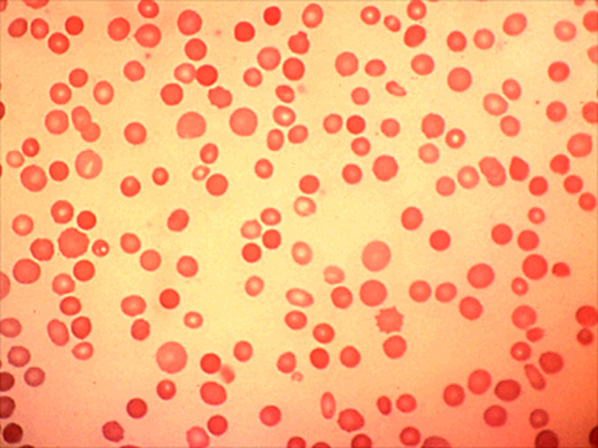
Hereditary Spherocytosis
Bethany Zeitler

Slide 2
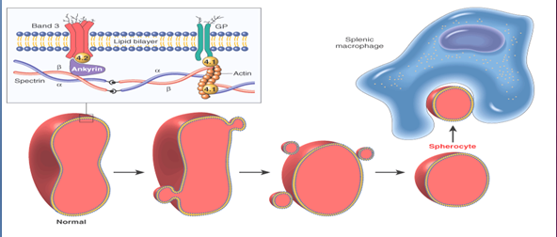
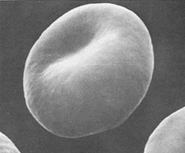
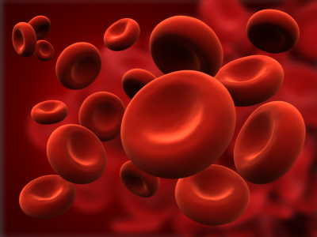
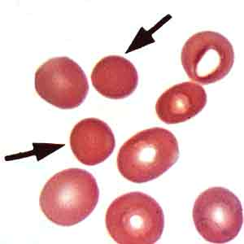
What Is Hereditary Spherocytosis (HS)?
http://mynotes4usmle.tumblr.com/post/33858515049/hereditarty-spherocytosis
Notes:
Can be recessive or dominant depending on mutation, most common in Northern Europeans

Slide 3
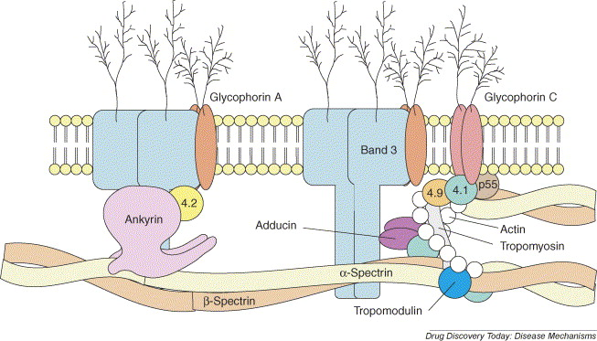
Red Blood Cell Membrane Structure
Liem and Gallagher. 2005. Molecular mechanisms in the inherited red cell membrane disorders. Science Direct Vol 2. Issue 4. 539-545. http://dx.doi.org/10.1016/j.ddmec.2005.11.004
Notes:
Can occur in any of those proteins but most commonly in ANK1 which is what I chose to study

Slide 4
HS is caused by mutations in Ank1
Human Ank1 Protein
Ankyrin Repeat
ZU5
DEATH
Missense mutations usually lead to decreased ankyrin and mild symptoms
Nonsense and frameshift mutations associated with dominant inheritance and severe anemia
Eber et al. 1996

Slide 5
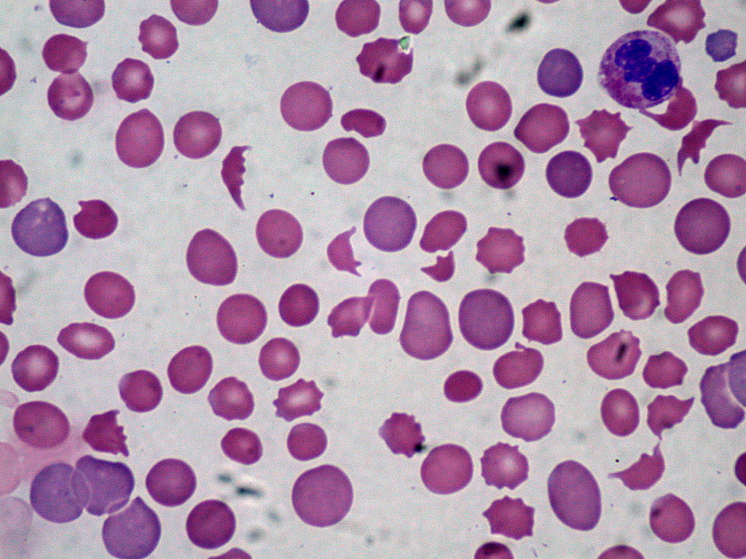
Anemia as a symptom of HS
http://www.youtube.com/watch?feature=player_embedded&v=88KWpmKtUJ8
http://upload.wikimedia.org/wikipedia/commons/9/92/DIC_With_Microangiopathic_Hemolytic_Anemia_(301920983).jpg
Notes:
Loss of surface area leads blood cells to burst when filtering through the spleen
Leads to low RBC count- Hemolytic Anemia
Main symptom: Fatigue due to low oxygen transport- a result of low hemoglobin

Slide 6
ANK1 is very well conserved
Ankyrin Repeat
ZU5
DEATH
Human
1880aa
Ankyrin Repeat
ZU5
DEATH
Chimp
1880aa
Ankyrin Repeat
ZU5
DEATH
Mouse
1907aa
Ankyrin Repeat
ZU5
DEATH
Zebrafi
1981aa
Ankyrin Repeat
ZU5
DEATH
Worm
6994aa

Slide 7
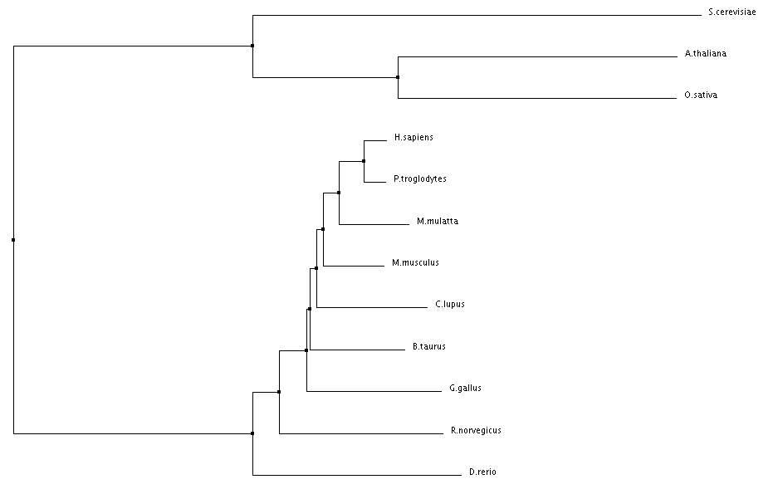
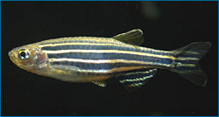
ANK1 Phylogeny
BLOOD

Slide 8
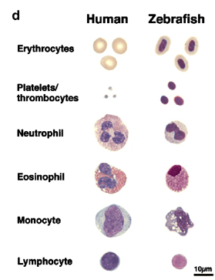

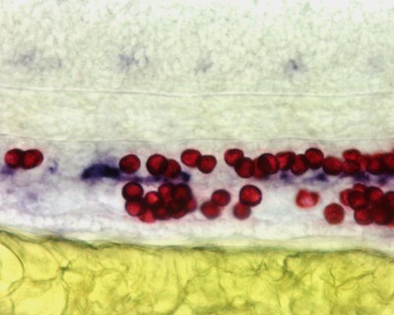
Human Blood vs. Zebrafish Blood
https://www.youtube.com/watch?feature=player_embedded&v=5l7RQAK8DH8
Davidson and Zon, 2004
http://2009annualreport.nichd.nih.gov/svo.html

Slide 9
Mutant zebrafish have anemia phenotypes
Merlot
Riesling
Liem and Gallagher. 2005. Molecular mechanisms in the inherited red cell membrane disorders. Science Direct Vol 2. Issue 4. 539-545. http://dx.doi.org/10.1016/j.ddmec.2005.11.004

Slide 10
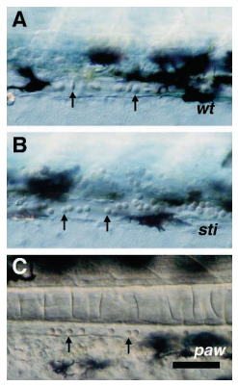
Hypothesis: The paw phenotype is caused by an ankyrin mutation
Weinstein, et al. 1996

Slide 11
Experiment 1: Genome sequencing to identify sti and paw mutations
Ankyrin 1 Like
Weinstein, et al. 1996

Slide 12
Sequencing the paw phenotype
Sequence
PCR Overlapping Regions
Determine Mutation
Chromosome 21
5’
Ank1-like Coding Region
3’
Promoter Region
Outermost Primers
Predicted Mutation

Slide 13
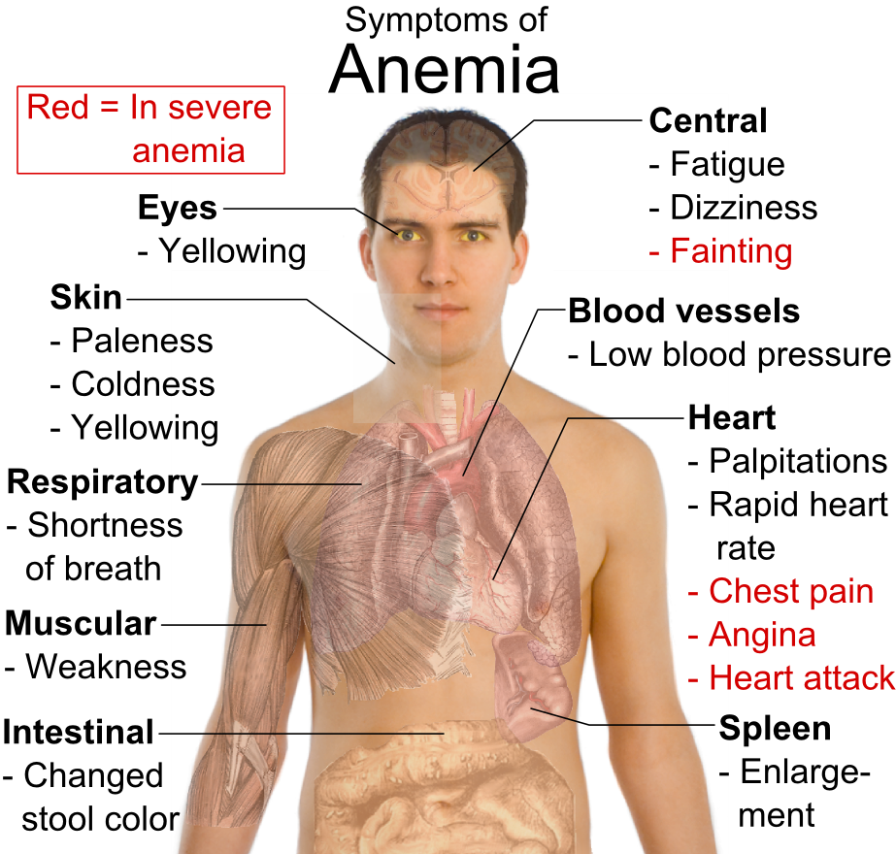
http://www.medexpressrx.com/blog/wp-content/uploads/2011/06/Symptoms_of_anemia.png

Slide 14
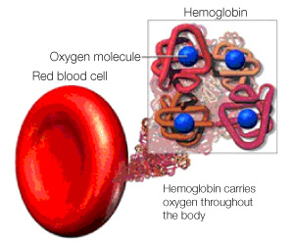
Hemolytic anemia causes lack of hemoglobin
Fewer Red Blood Cells
Less Hemoglobin
Less Oxygen Transport
Fatigue

Slide 15

Can I modulate hemoglobin in paw mutants to rescue the fatigue phenotype?
Hypothesis: Changing expression of hemoglobin reduces fatigue in paw mutants

Slide 16
Experiment 2: Chemical screen to reduce fatigue
Identify hemoglobin transcription modifiers
Chemical screen to regulate transcription factor
Observe fish behavior

Slide 17
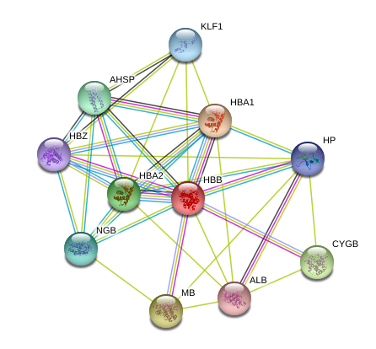
Human hemoglobin transcription is activated by Klf1
Transcription factor
Hemoglobin Subunits

Slide 18
Klf1 Homolog in Zebrafish
Human Klf1
362 aa
Zebrafish Klf4
409 aa
Zinc-finger Domains: DNA-Binding

Slide 19
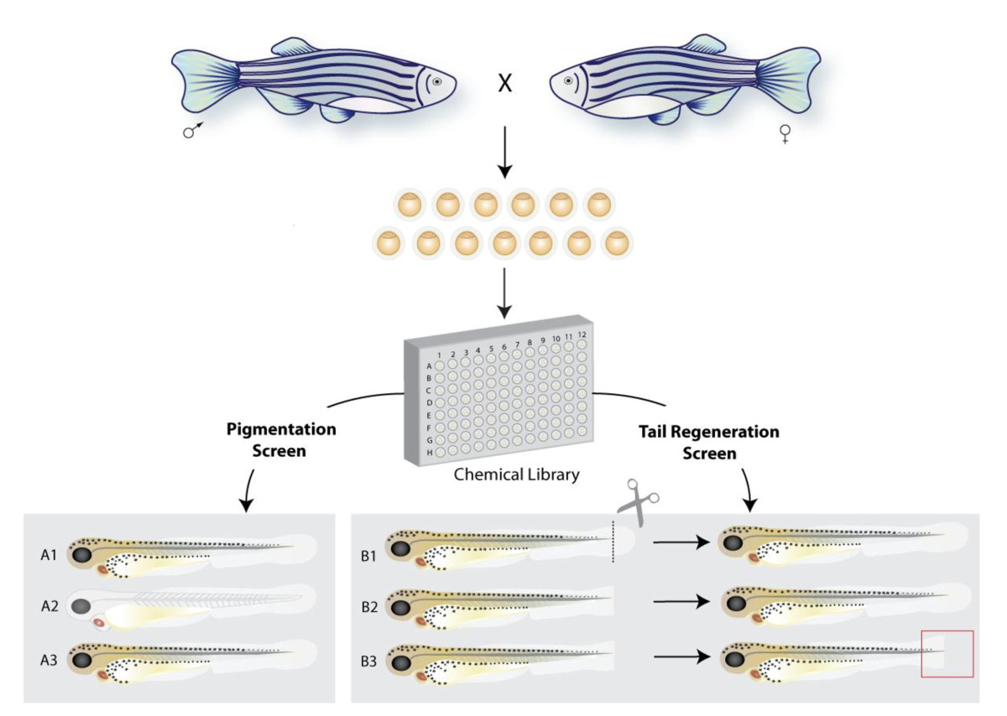
Chemical screen to modulate Klf4
http://www.biosignaling.com/content/figures/1478-811X-8-11-1-l.jpg

Slide 20
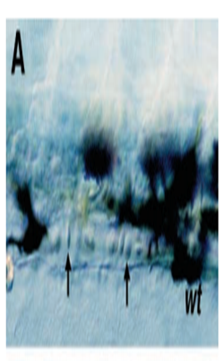
More hemoglobin will make fish swim
Wild Type
Paw
Paw + Drug
Normal blood shape and count
Spherocytes, Low blood cell count
Spherocytes, Low blood cell count
Normal swimmer (Wild Type)
Slow swimmer (Fatigue)
Normal swimmer (Wild Type)

Slide 21
Future Directions
Can we relieve anemia symptoms of those with HS?
  Continue studies in mice to better see behavioral changes

